Slide 1
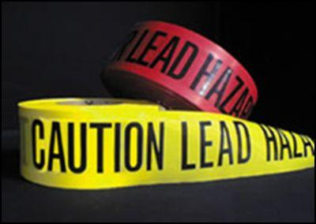
SAFETY ALERT
Based upon the recommendation of the National Institute for Occupational Safety and Health. Local 2266 would like to inform our members of these recommendation to minimize possible lead exposure after participating in activities at the firearms ranges.
Personal hygiene is important for protecting employees from exposure to lead dust and for preventing the transfer of lead out of the workplace. All employees exposed to lead should wash their hands and faces (cold water) with lead removal wipes or soap before eating, drinking, or smoking. Additionally, they should not eat, drink, or use tobacco products (cigarettes, cigars, chewing tobacco, etc.) in the firing range, gun cleaning area, or classroom.
Employees should change into work clothes and shoes upon arrival at the worksite. Street clothes and shoes should be stored separately from work clothes in a clean area. Contaminated work clothes should be removed before eating and replaced with a clean set of work clothes. Alternatively, disposable shoe covers could be put on prior to entering the range and then discarded upon leaving the range. Employees should change back into their street clothes and shoes after washing their hands and faces and before leaving the range.
We encourage you to discuss your work and possible lead exposures with your healthcare provider. If you have children, we recommend you discuss this possible source of lead exposure with their doctor.
EXECUTIVE BOARD
LOCAL 2266

